Slide 1

Green Pace
Security Policy Presentation
Developer: Xavier Sepulveda

Slide 2

OVERVIEW: DEFENSE IN DEPTH

Slide 3
THREATS MATRIX
Threats should be prioritized by severity. Low level threats are just as important, but high priority threats must be taken care of first because they leave the company at a higher risk of a security breach.
Likely STD-002-CPP (Data Values) STD-005-CPP (Memory Protection) STD-003-CPP (String Correctness) STD-004-CPP (SQL Injection) STD-007-CPP (Exceptions) STD-008-CPP (Containers) STD-009-CPP (Memory Management) | Priority STD-002-CPP (Data Values) P12 STD-005-CPP (Memory Protection) P12 STD-003-CPP (String Correctness) P18 STD-004-CPP (SQL Injection) P18
Low priority STD-006-CPP (Assertions) P1 STD-001-CPP (Data Types) P3 STD-010-CPP (Input Output) P4 STD-008-CPP (Containers) P6 STD-009-CPP (Memory Management) P6 STD-007-CPP (Exceptions) P9 | Unlikely STD-006-CPP (Assertions) STD-001-CPP (Data Types) STD-010-CPP (Input Output)

Slide 4
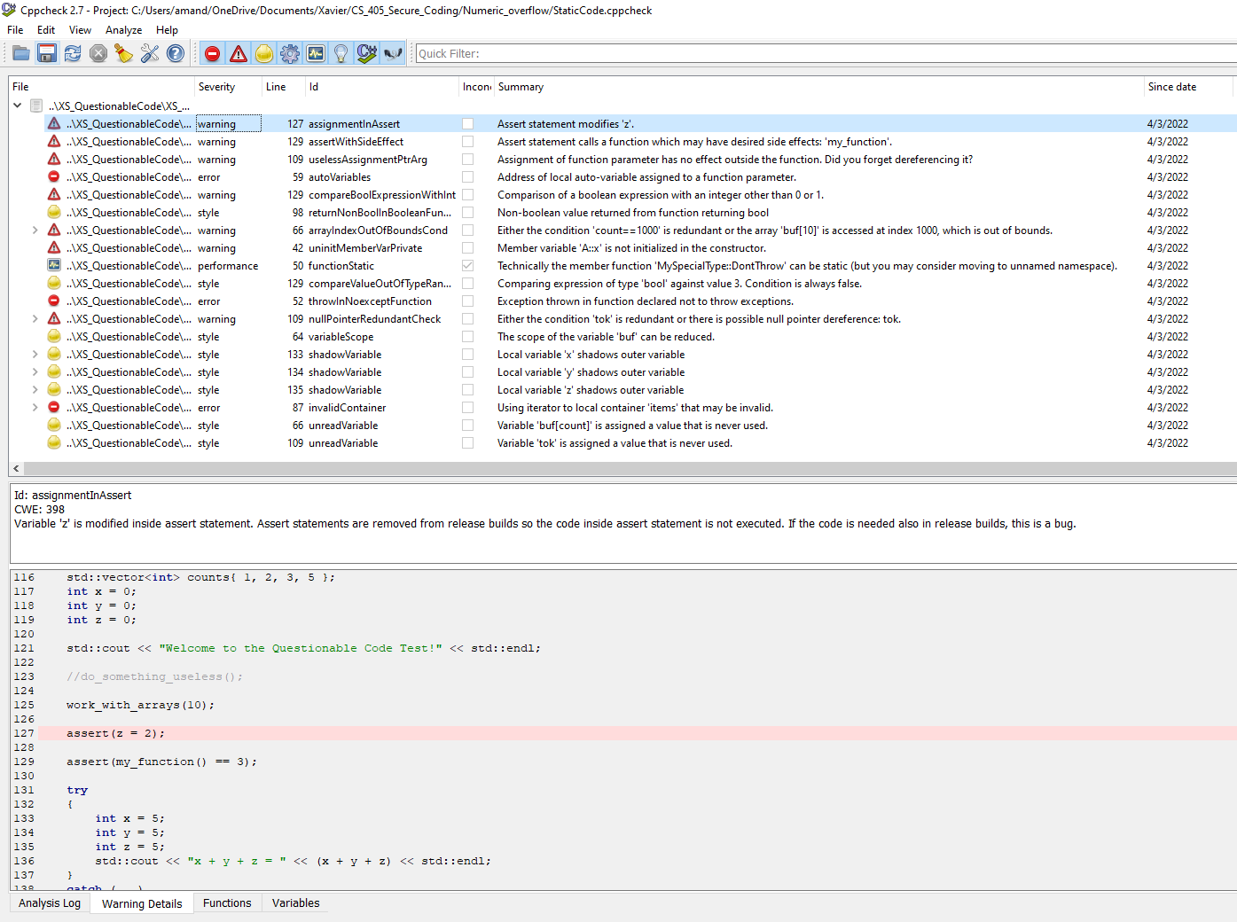
Using automation to detect vulnerabilities.

Slide 5
10 PRINCIPLES
Validate Input Data
Heed Compiler Warnings
Architect and Design for Security Policies
Keep It Simple
Default Deny
Adhere to the Principle of Least Privilege
Sanitize Data Sent to Other Systems
Practice Defense in Depth
Use Effective Quality Assurance Techniques
Adopt a Secure Coding Standard

Slide 6
CODING STANDARDS
1. STD-001-CPP - Must declare identifiers, variables, and functions before utilizing.
2. STD-002-CPP - Do not read uninitialized int/variables
3. STD-003-CPP - Make sure that storage for string object has ample space char data and null terminator.
4. STD-004-CPP - Sanitize data that is passed from different systems.
5. STD-005-CPP - Freed memory should not be accessed.
6. STD-006-CPP - Use assertions to test values of constant expressions.
7. STD-007-CPP - Handle exceptions thrown prior to the main() functions is executed.
8. STD-008-CPP - Use valid iterators to reference the proper elements of the container.
9. STD-009-CPP - Make sure there is adequate memory for an object.
10. STD-010-CPP - Closed files should not be accessed.

Slide 7
ENCRYPTION POLICIES
Encryption in rest
Encryption at flight/transit
Encryption in use

Slide 8
TRIPLE-A POLICIES
Authentication – Who are you?
Authorization – What can you use?
Accounting – What happened, and when?

Slide 9
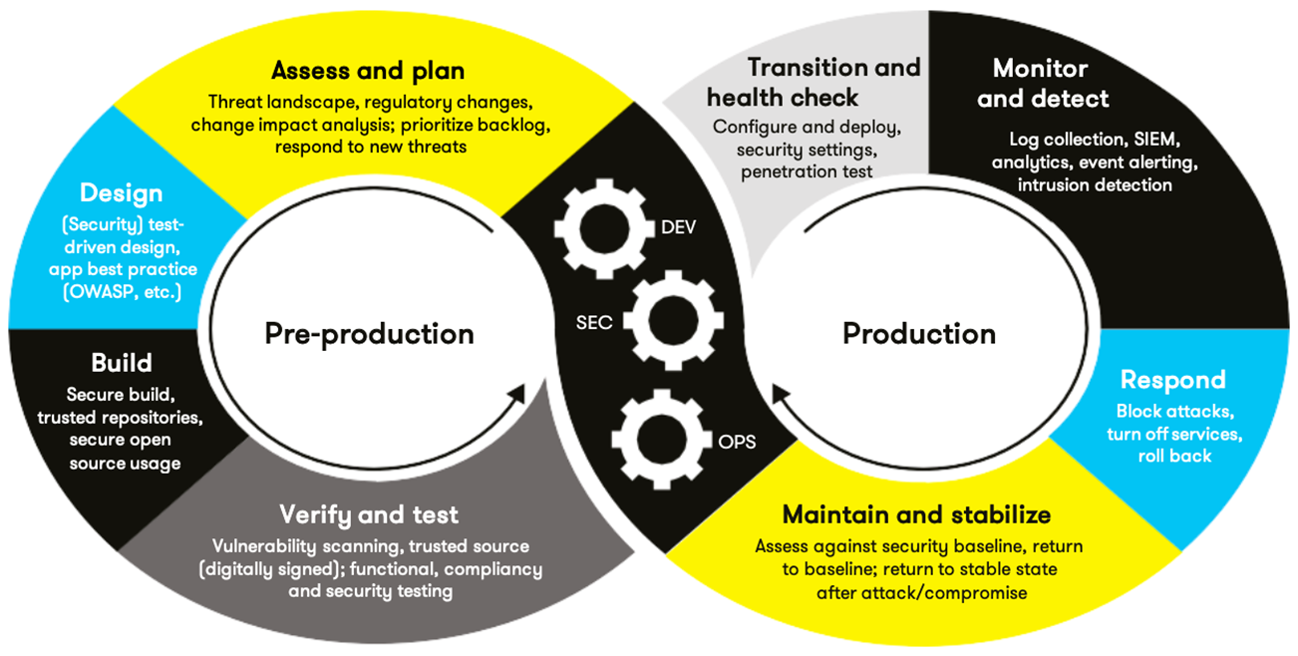
AUTOMATION SUMMARY & TOOLS
Cppcheck
LTAuditor
GFI LandGuard

Slide 10
RISKS AND BENEFITS
Don’t leave security to the end
Priority
Continue to improve

Slide 11
RECOMMENDATIONS
Test, Test, Test!
Keep human error In mind
Enforce policies

Slide 12
CONCLUSIONS
Don’t leave security to the end
Keep it simple
Continue to test
Default deny
Follow the standards and policies

Slide 13
REFERENCES
Britton, J. & Gennari, J. (2021, November 30). MEM35-C. Allocate sufficient memory for an object. Retrieved from https://wiki.sei.cmu.edu/confluence/display/c/MEM35-C.+Allocate+sufficient+memory+for+an+object
Britton, J. & Pincar, J. (2021, December 09). STR-CPP. Guarantee that storage for strings has sufficient space for character data and the null terminator. Retrieved from https://wiki.sei.cmu.edu/confluence/display/cplusplus/STR50-CPP.+Guarantee+that+storage+for+strings+has+sufficient+space+for+character+data+and+the+null+terminator
Britton, J & Seacord, R. (2018, December 11). DLC03-C. Use a static assertion to test the value of a constant expression. Retrieved from https://wiki.sei.cmu.edu/confluence/display/c/DCL03-C.+Use+a+static+assertion+to+test+the+value+of+a+constant+expression
Britton, J & Seacord, R. (2021, April 23). FIO46-C. Do not access a closed file. Retrieved from https://wiki.sei.cmu.edu/confluence/display/c/FIO46-C.+Do+not+access+a+closed+file
ENCRYPTION: UNDERSTANDING DATA AT REST VS. IN TRANSIT. (2021, September 01). Retrieved from https://datalocker.com/blog/technology/encryption/encryption-at-rest-vs-in-transit-effectively-encrypt-identifiable-information/
Gangopadhyay, A & Seacord, J. (2021, July 19). ERR58-CPP. Handle all exceptions thrown before main() begins executing. Retrieved from https://wiki.sei.cmu.edu/confluence/display/cplusplus/ERR58-CPP.+Handle+all+exceptions+thrown+before+main%28%29+begins+executing
Herter, J & Seacord, R. (2020, August 13). STR02-C. Sanitize data passed to complex subsystems. Retrieved from https://wiki.sei.cmu.edu/confluence/display/c/STR02-C.+Sanitize+data+passed+to+complex+subsystems
Long, F. & O’Donnell, J. (2021, December 29). CTR51-CPP. Use valid references, pointers, and iterators to reference elements of a container. Retrieved from https://wiki.sei.cmu.edu/confluence/display/cplusplus/CTR51-CPP.+Use+valid+references%2C+pointers%2C+and+iterators+to+reference+elements+of+a+container
OpsCompass Staff. (2015, July 10). Are you encrypting you data-in-flight? If not, you should be. Retrieved from https://opscompass.com/resources/blog/are-you-encrypting-your-data-in-flight-if-not-you-should-be/#:~:text=Encrypting%20data%20in%2Dflight%20means,being%20transmitted%20over%20a%20network.
Pincar, J. & Razmyslov, S. (2021, June 25). EXP53-CPP. Do not read uninitialized memory. Retrieved from https://wiki.sei.cmu.edu/confluence/display/cplusplus/EXP53-CPP.+Do+not+read+uninitialized+memory
Razmyslov, S. & Seacord, R. (2021, June 24). DCL31-C. Declare identifiers before using them. Retrieved from https://wiki.sei.cmu.edu/confluence/display/c/DCL31-C.+Declare+identifiers+before+using+them
Razmyslov, S. & Seacord, R. (2021, June 24). MEM30-C. Do not access freed memory. Retrieved from https://wiki.sei.cmu.edu/confluence/display/c/MEM30-C.+Do+not+access+freed+memory
Schiela, R. & Seacord, R. (2018, May 02). Top 10 Secure Coding Practices. Retrieved from https://wiki.sei.cmu.edu/confluence/display/seccode/Top+10+Secure+Coding+Practices
“Protect your network” with patch management, auditing, and security scanning. (2022, April 12). Protect your network with patch management, auditing, and security scanning. Retrieved from https://www.gfi.com/products-and-solutions/network-security-solutions/gfi-languard

